Slide 1
Course Capstone Project Proposal Title: Smart Navigation Stick with GPS & GSM Tracking for Visually Impaired Individuals
Course Code: | EEE 4103 | Course Name: | Microprocessor and Embedded Systems
Course Teacher:
Department of Electrical and Electronic Engineering
SL # | Students ID | Students Name | Program | Section
1 | 22-XXXX-X |  | BSc in EEE | X
2 | 22-XXXX-X |  | BSc in CSE | X
3 | 22-XXXX-X |  | BSc in CSE | X
4 | 22-XXXX-X |  | BSc in CSE | X
5 | 22-XXXX-X |  | BSc in CSE | X

Slide 2

Outline of the Presentation
Aims and Objectives
Introduction
Literature Review
Research Gaps and Improvements in Our Work
Working Method
Methodology
Equations
Survey Report
Gantt Chart
Results and Discussions
Conclusions
Future Scopes

Slide 3
Aims and Objectives of the Work
To develop a smart navigation stick that enhances mobility and safety for visually impaired individuals.
To implement real-time location tracking using GPS and emergency communication via GSM.
To incorporate ultrasonic sensors for accurate obstacle detection and buzzers for timely alerts.
To design a user-friendly and compact embedded system based on Arduino.
To simulate various navigation scenarios to optimize sensor placement and response time.
To test the device with different user groups to assess usability and reliability.

Slide 4
Introduction(Background)
Over 285 million people globally suffer from visual impairments, around 39 million are completely blind
Traditional white canes provide limited obstacle detection and lack intelligent assistance
Visually impaired individuals face daily challenges in navigation, obstacle avoidance, and locating their position
Urban environments increase the risk of accidents and disorientation for the visually impaired
Emergency response becomes difficult due to the lack of real-time location tracking and communication

Slide 5
Introduction(Motivation & Need)
There is a growing need for smart assistive devices that are reliable, portable and cost-effective
GPS modules can provide accurate outdoor location tracking to assist navigation and emergency response
GSM modules allow real-time communication with caregivers during emergencies
Ultrasonic sensors enable proactive obstacle detection and alerting through sound or vibration
Integrating all components into a single stick can empower the visually impaired with greater autonomy

Slide 6
Literature Review
Khan et al. (2017) developed a smart cane with ultrasonic sensors for obstacle detection
→ Effective in identifying nearby objects but lacked GPS and communication capability
Roy et al. (2019) implemented a blind navigation system using GPS and GSM modules
→ Enabled real-time tracking and SMS alerting but showed poor performance indoors
Rahman et al. (2020) designed a voice-based blind assistive stick
→ Used voice commands for guidance, but faced limitations in noisy environments
Ahmed et al. (2021) introduced a stick with vibration feedback and obstacle alert
→ Silent feedback was user-friendly, but no emergency communication system was provided

Slide 7
Research Gaps and Improvements in Our Work
Previous systems are limited to one or two features – either navigation or communication
Many systems failed to ensure real-time emergency response through reliable GSM alerts
Some lacked battery-efficient designs, causing shorter operating time
Our work improves by:
→ Combining obstacle detection, real-time GPS and emergency SMS in one compact design
→ Using a button-triggered emergency system that sends a live Google Maps link
→ Ensuring cost-effectiveness and ease of use for visually impaired adults in rural areas

Slide 8
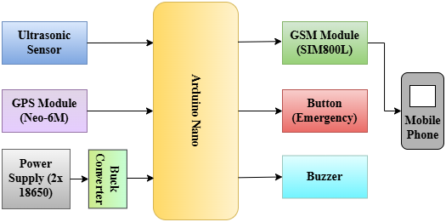
Working Method
Working Flow of the Smart Blind Stick :
Power System
Two 18650 Li-ion batteries power Arduino Nano and other modules.
Obstacle Detection
Ultrasonic sensor (HC-SR04) continuously scans surroundings.
If an object is within 36 centimeter's, Arduino triggers a buzzer alarm.
GPS Location Tracking
GPS (Neo-6M) fetches current coordinates.
Emergency SMS Function
A button is available on the stick. When pressed, Arduino sends the GPS location via SIM800L GSM module in Google Maps format.
User Alerts
Buzzer notifies user instantly upon detecting nearby objects.
Block Diagram of Smart Navigation Stick with GPS & GSM Integration

Slide 9
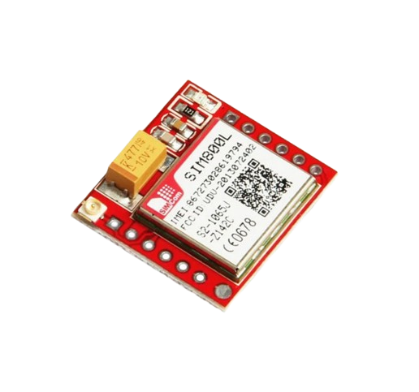
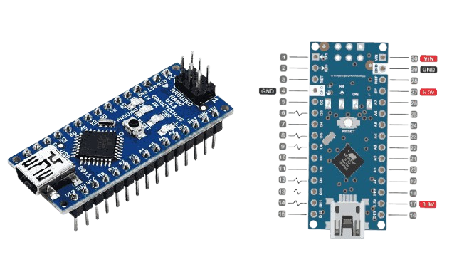
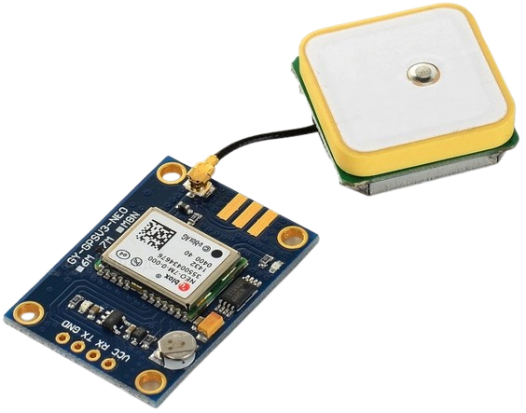
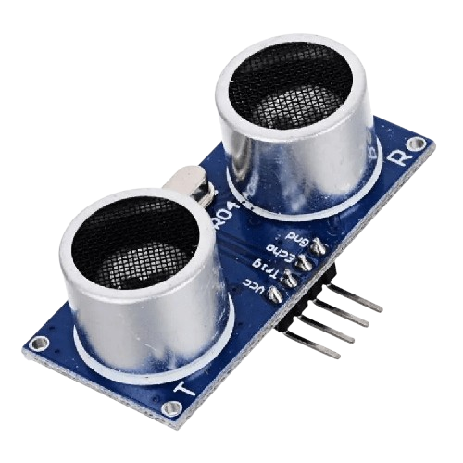
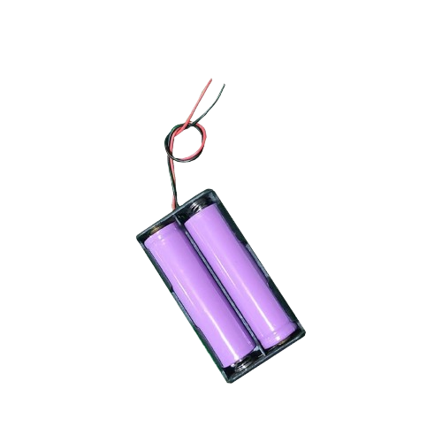
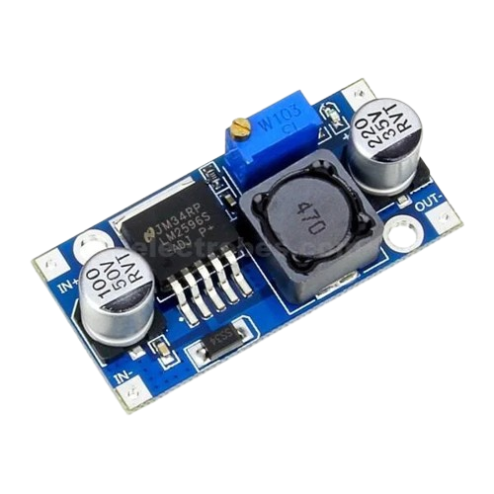
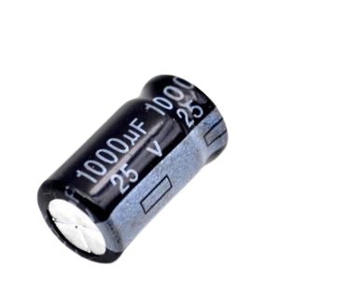
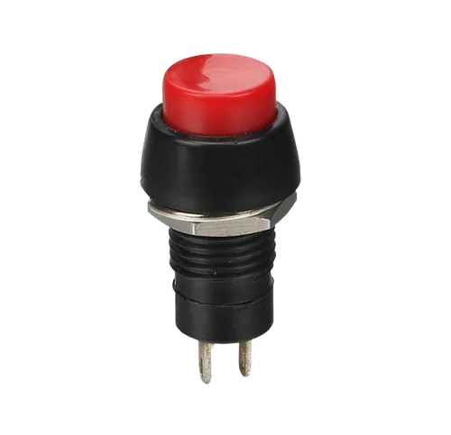
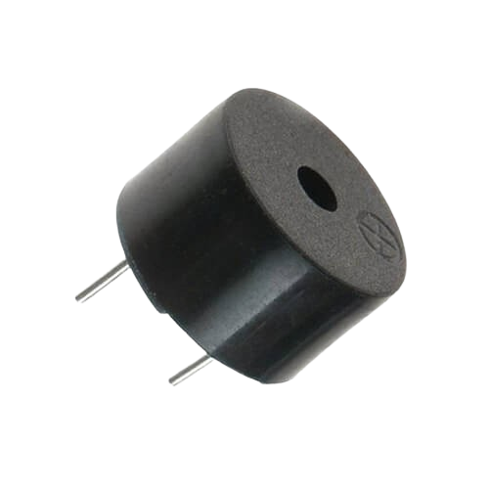
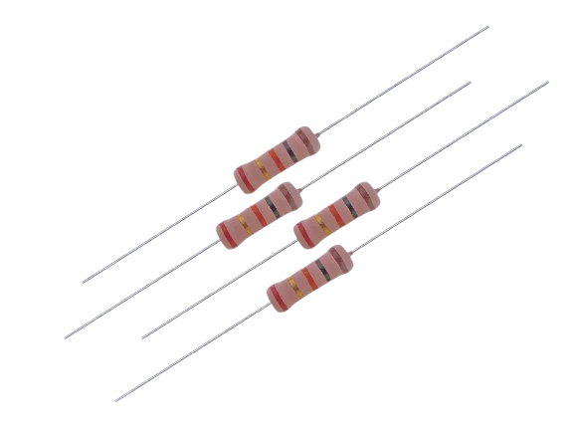
Methodology(Hardware Design and Integration)
Component Selection and Purpose :
Arduino Nano Main controller for sensor data processing and communication.
SIM800L GSM Sends SMS alerts with current GPS location.
NEO-6M GPS Provides real-time latitude and longitude.
HC-SR04 Sensor Measures obstacle distance using ultrasonic sound waves.
1000µF Capacitor Stabilizes voltage during GSM power spikes.
2× 18650 Batteries Power supply via buck converter.
Emergency Button Sends SMS with location when pressed.
Buzzer Alerts user when obstacle is detected.
Voltage Divider (2.2kΩ & 1kΩ) Reduces 5V TX to safe
Buck Converter Steps down battery voltage to 4.3V for GSM module.

Slide 10
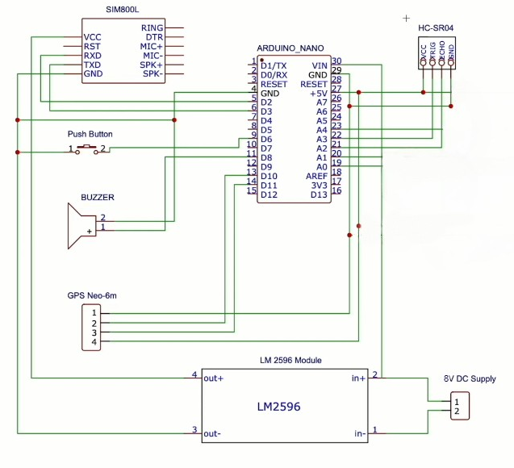
Methodology
Circuit Design and Power Management:
Ultrasonic sensor connected to analog pins A0 (Echo) and A1 (Trig)
GPS TX → D11, RX → D10 (via SoftwareSerial)
SIM800L RX → D3 (via voltage divider), TX → D2
Buzzer on D5, Button on D6
GSM powered via buck converter (output ~4.0–4.2V)
Arduino powered via VIN pin from 2x18650 batteries
(Due to the unavailability of specific modules like the SIM800L GSM and Neo-6M GPS in Proteus, full simulation of the system could not be conducted in Proteus)

Slide 11
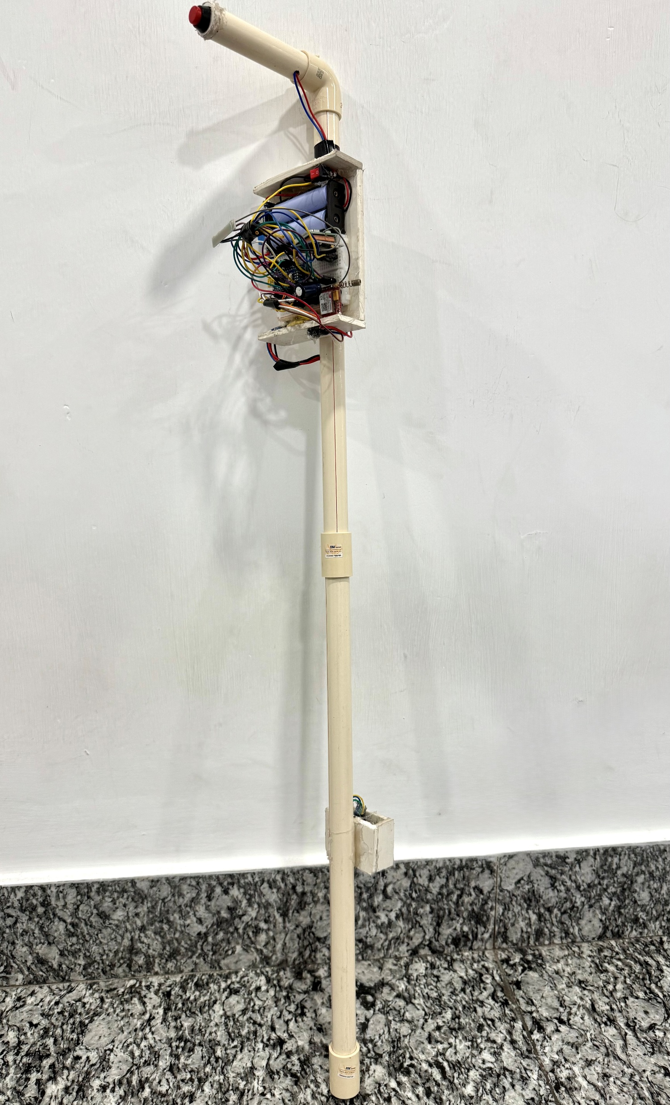
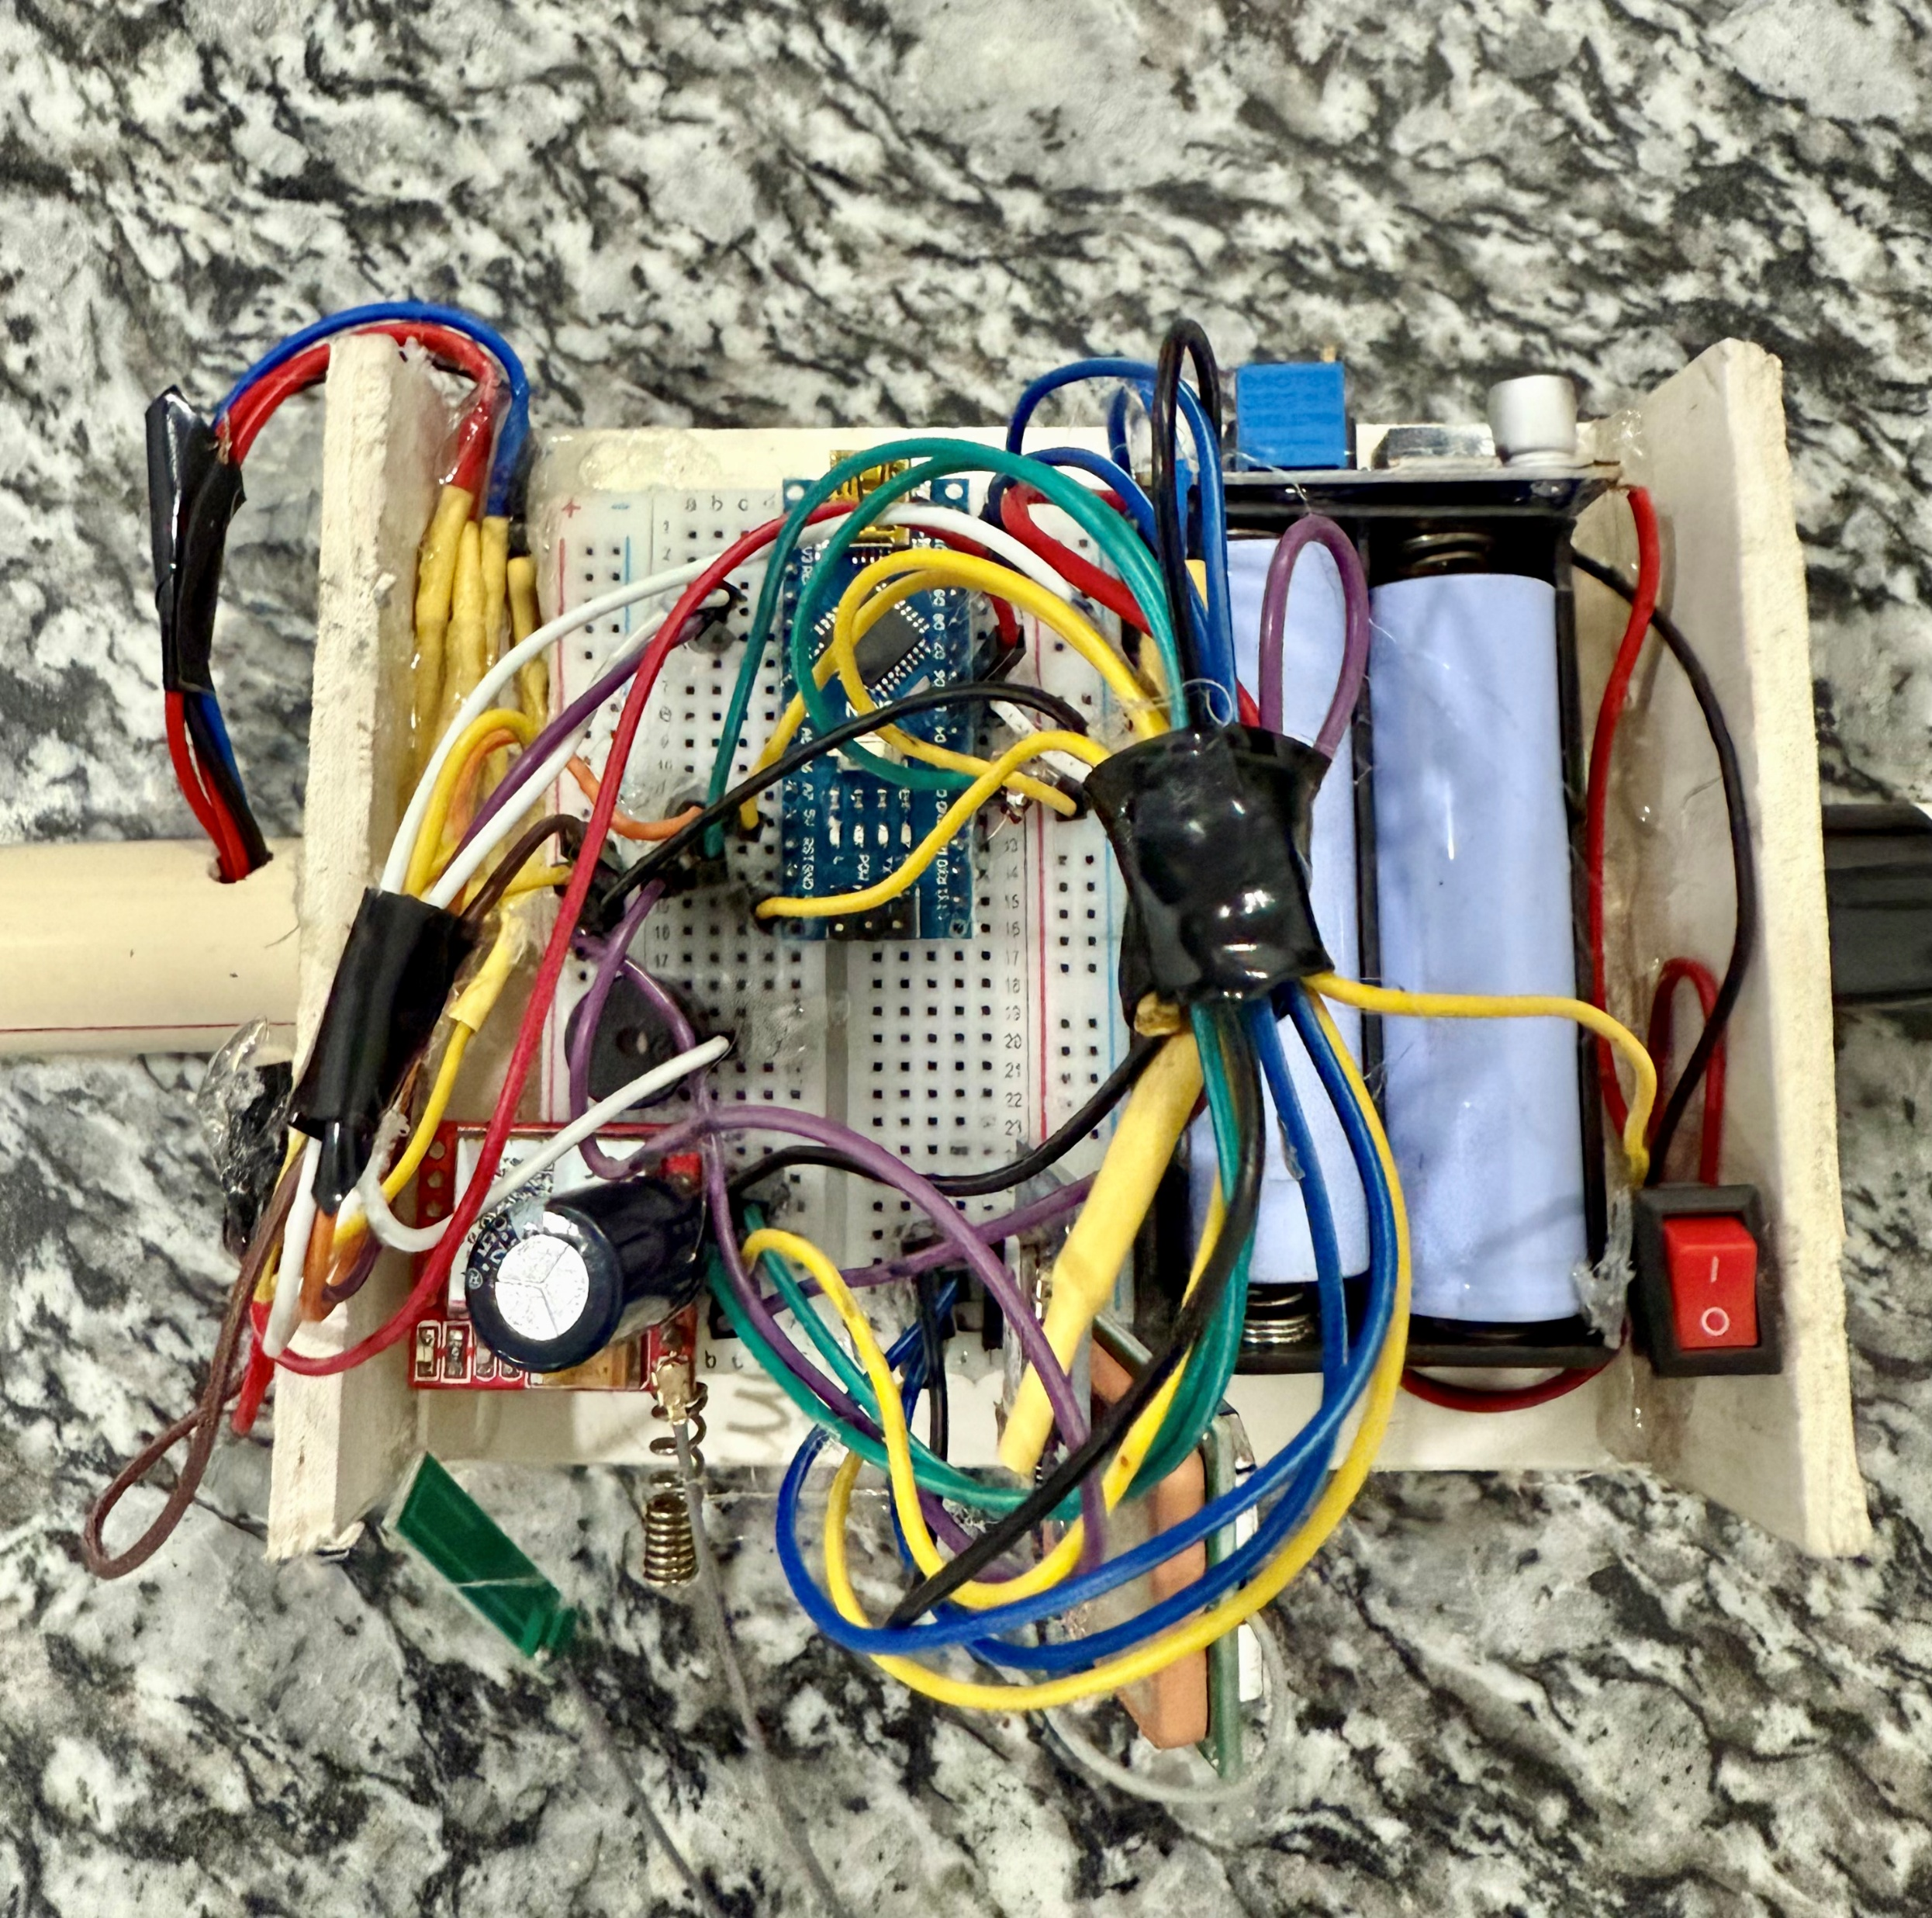
Methodology
The prototype demonstrates the practical integration of all key hardware components into a single compact stick. It includes the Arduino Nano, ultrasonic sensor for obstacle detection, Neo-6M GPS module, SIM800L GSM module for emergency communication and a buzzer for real-time feedback. The design is powered by dual 18650 Li-ion batteries and optimized for portability, making it highly suitable for visually impaired users. The button near the handle triggers emergency SMS alerts containing real-time GPS location.

Slide 12
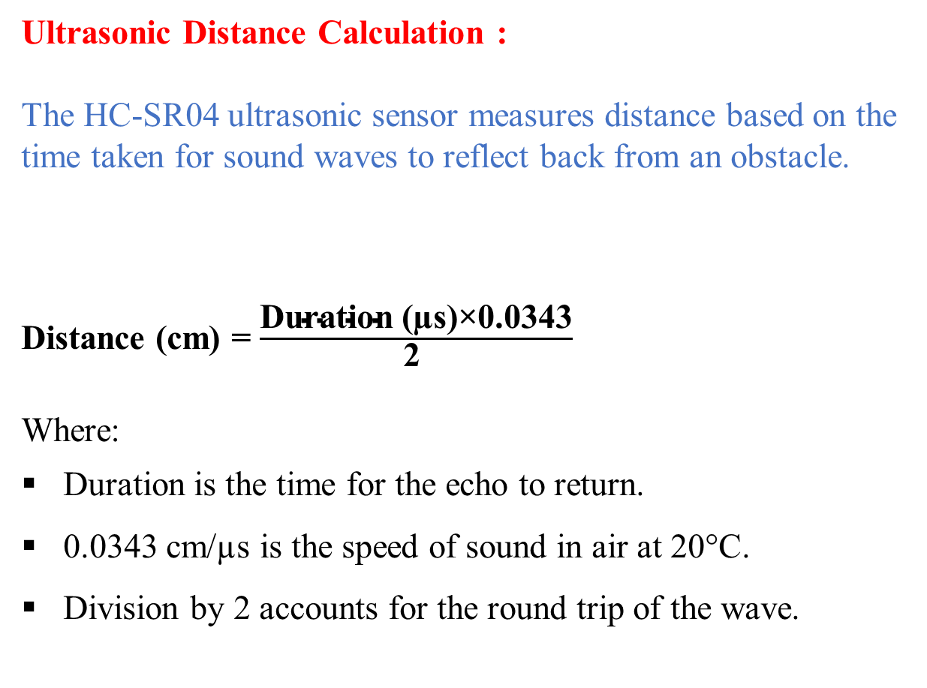
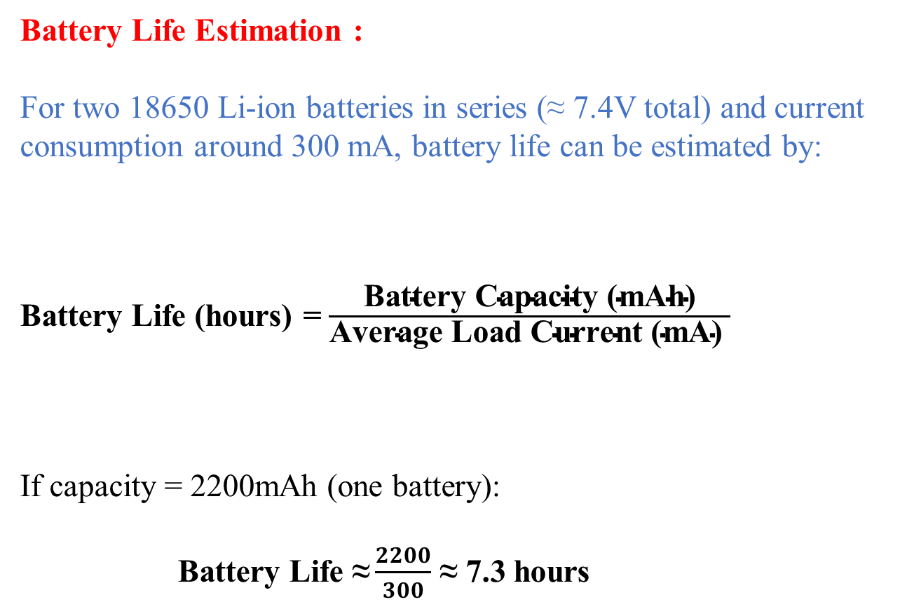
Equations
Ultrasonic Distance Calculation :
The HC-SR04 ultrasonic sensor measures distance based on the time taken for sound waves to reflect back from an obstacle.
Distance (cm) = $\frac{\text{Duration}\text{ (µ}\text{s}\text{)×0.0343​}}{\text{2 }}$
Where:
Duration is the time for the echo to return.
0.0343 cm/µs is the speed of sound in air at 20°C.
Division by 2 accounts for the round trip of the wave.
Battery Life Estimation :
For two 18650 Li-ion batteries in series (≈ 7.4V total) and current consumption around 300 mA, battery life can be estimated by:
Battery Life (hours) = $\frac{\text{Battery} \text{Capacity}\text{ (}\text{mAh}\text{)​​}}{\text{Average} \text{Load} \text{Current}\text{ (}\text{mA}\text{) }}$
If capacity = 2200mAh (one battery):
Battery Life $\text{≈}\frac{2200}{300\text{​}}$ ≈ 7.3 hours

Slide 13
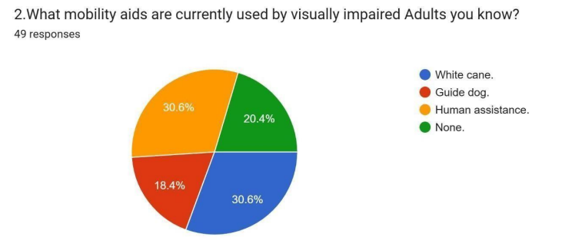
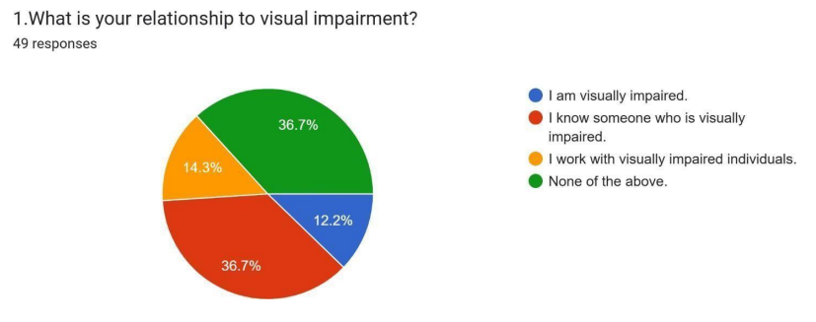
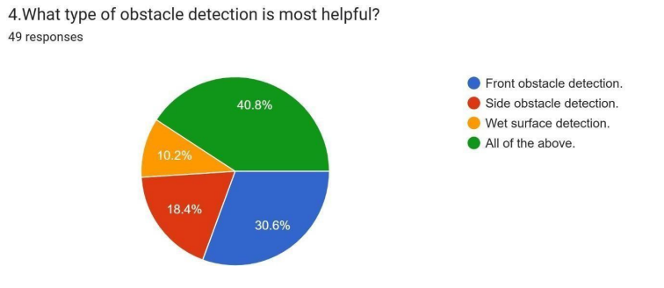
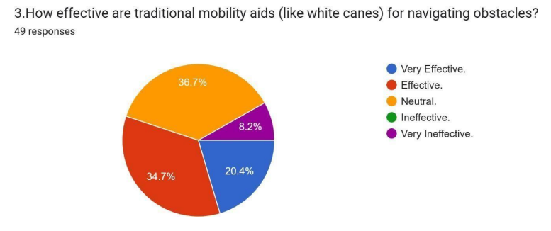
Survey Report

Slide 14
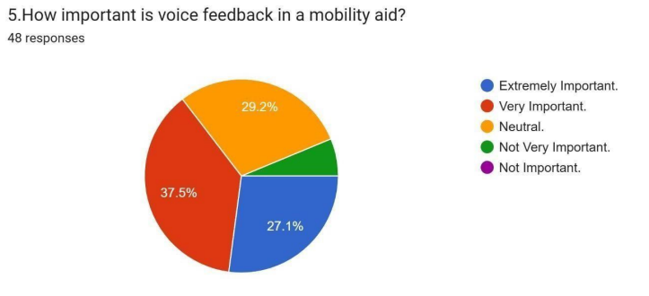
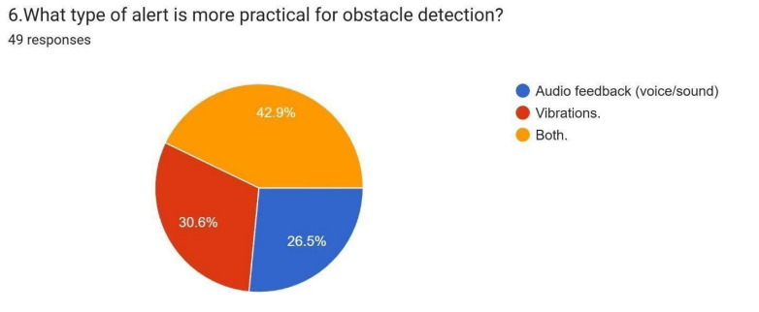
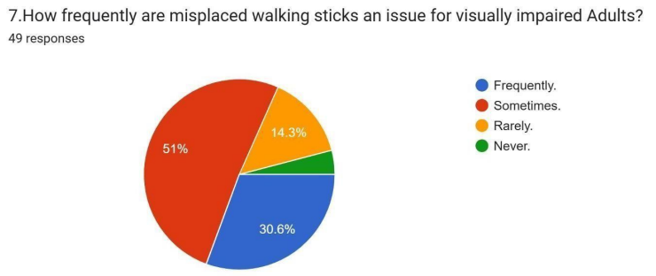
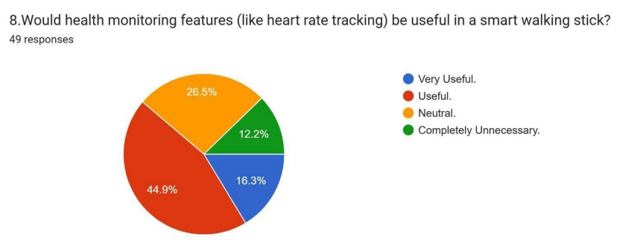
Survey Report

Slide 15
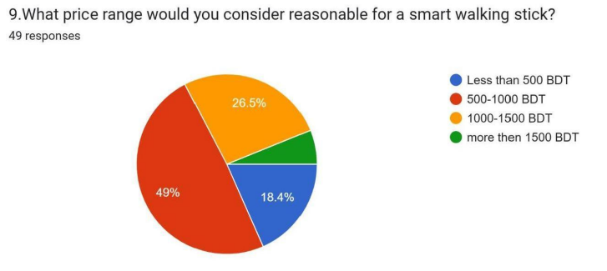
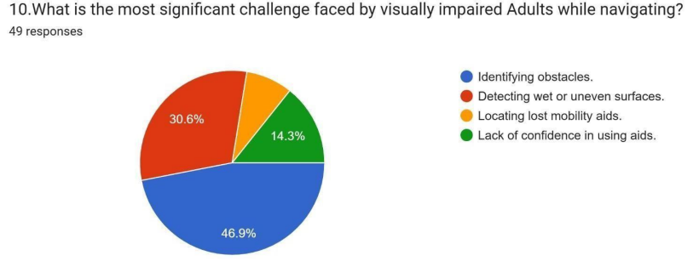
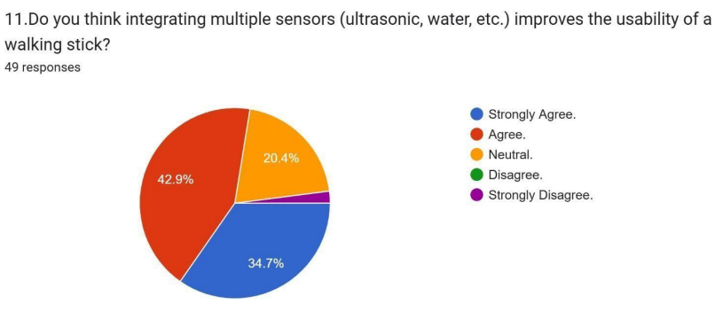
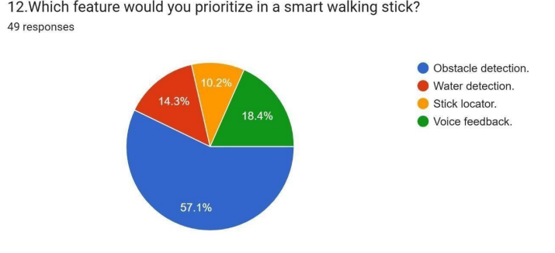
Survey Report

Slide 16
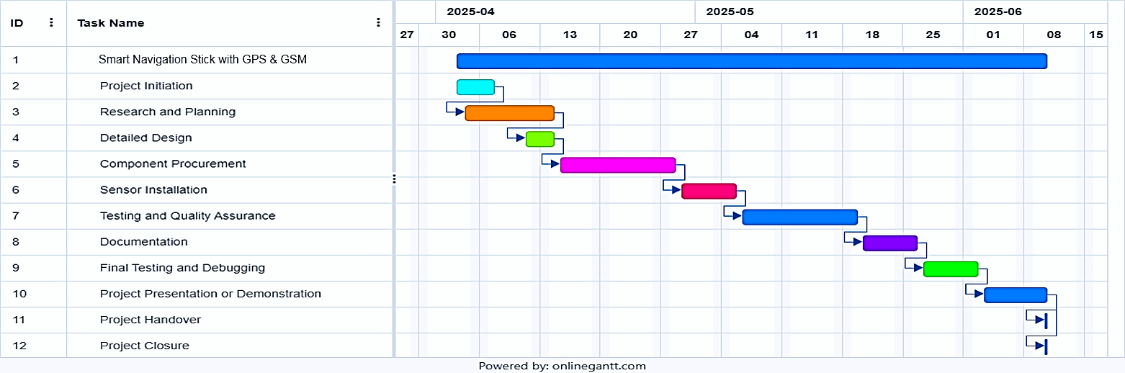
Project Timeline
Gantt Chart

Slide 17
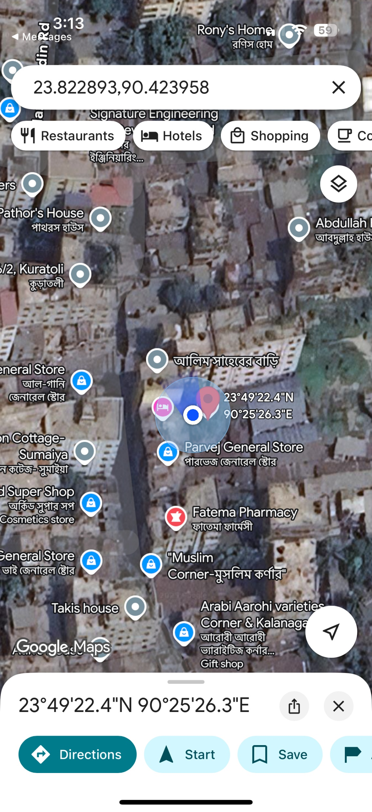
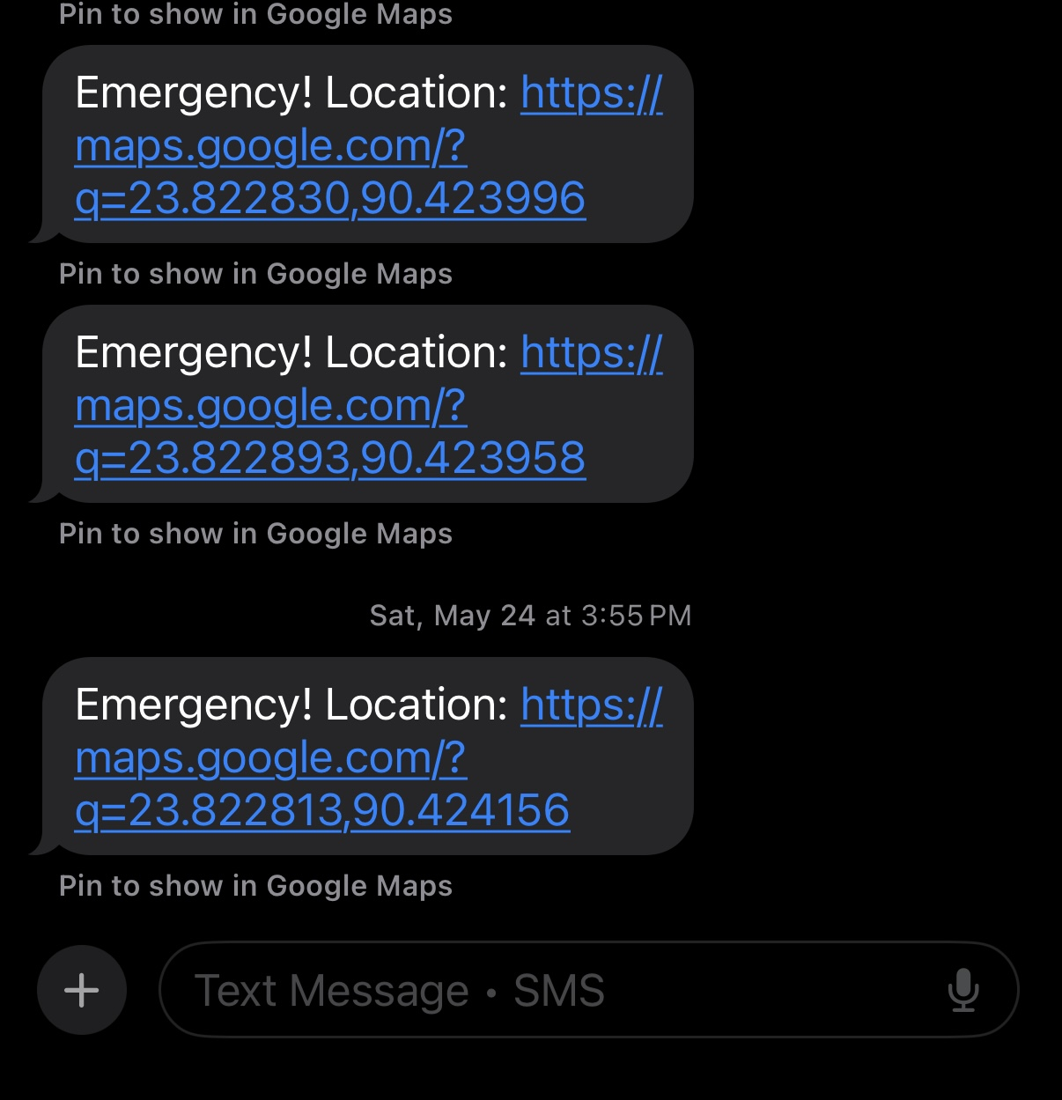
Results and Discussions
The smart stick effectively detected obstacles within 36 centimeter's and triggered the buzzer instantly. GPS provided real-time outdoor location with good accuracy, while GSM sent emergency SMS with Google Maps links in 3–5 seconds. Users found the alerts useful and the stick easy to handle. Minor delays were observed in GSM performance under weak signals, and GPS was less accurate indoors. The battery lasted 7–8 hours on a full charge.

Slide 18
Conclusions
The smart stick effectively enhances mobility and safety for visually impaired individuals.
It integrates obstacle detection, GPS tracking and GSM communication in a compact, low-cost design.
Real-time alerts and emergency messaging improve user confidence and independence.
The device performed reliably in outdoor conditions with satisfactory user feedback.

Slide 19
Future Scopes
Add voice guidance or vibration feedback for better indoor navigation.
Integrate IoT features for real-time monitoring via mobile apps.
Implement obstacle classification using AI (example: Identifying stairs or moving objects).
Improve power efficiency and include solar charging for longer usage.
Design a waterproof and more ergonomic casing for real-world durability.

Slide 20
Thanks for listening our presentation….
?

